Slide 1

Upset Prevention and Recovery Training
UPRT
Created By Sqn.Ldr. Sattapon Arunsri
Notes:
เนื้อหาที่สร้างโดย AI อาจไม่ถูกต้อง
---
การฝึก UPRT หรือ Upset Prevention and Recovery Training เป็นการฝึกที่สำคัญเพื่อช่วยนักบินในการป้องกันและฟื้นฟูจากสถานการณ์ Upset ที่อาจเกิดขึ้นในระหว่างการบิน การฝึกนี้มีบทบาทสำคัญอย่างยิ่งต่อความปลอดภัยในอุตสาหกรรมการบิน
แหล่งที่มาของรูปภาพ: ไลบรารีเนื้อหาของ Microsoft 365

Slide 2


หัวข้อในการนำเสนอ
ที่มาและองค์ประกอบของ UPRT
Knowledge ความรู้ที่เกี่ยวข้อง
Causes And Contribution Faction of Upset
UPRT Strategy
Air work
Notes:
---
ในนําเสนอนี้ เราจะพูดถึงนิยามและองค์ประกอบของ UPRT ปัจจัยและสาเหตุของสถานการณ์ Upset เป้าหมายของการฝึก และหลักการสำคัญในการแก้ไขสถานการณ์ Upset เพื่อให้เกิดความเข้าใจและการนำไปใช้จริงอย่างมีประสิทธิภาพ
แหล่งที่มาของรูปภาพ: ไลบรารีเนื้อหาของ Microsoft 365

Slide 3
ที่มาและองค์ประกอบของUPRT
Notes:
เราจะทบทวนความหมายของ UPRT และบทบาทของมันในอุตสาหกรรมการบิน พร้อมทั้งศึกษานิยามและคำจำกัดความ 4 ข้อของสถานการณ์ Upset และตัวอย่างเหตุการณ์จริงที่สอดคล้องกับนิยามดังกล่าว

Slide 4
อักษรย่อยที่สำคัญ
LOC-I :: Loss of Control in Flight
UPRT :: Upset Prevention and Training
FSTD :: Flight Simulator Training Device
LOCART :: Loss of Control Avoidance and Recovery Training

Slide 5

UPRT
Upset Prevention and recovery Training
การฝึกอบรมเกี่ยวกับการแก้ไขสภาพท่าทางการบินที่ผิดปกติ ให้กลับคืนสู่ท่าทางการบินที่เหมาะสม
เป็นการฝึกเพื่อป้องกันและกู้คืนเครื่องบินจากภาวะผิดปกติที่อาจนำไปสู่อุบัติเหตุ เช่น การสูญเสียการควบคุม (Loss of Control In-Flight: LOC-I) ซึ่งเป็นสาเหตุหลักของอุบัติเหตุทางการบินทั่วโลก

Slide 6
Timeline
ก่อนปี ค.ศ. 2000 การฝึกบินมักมุ่งเน้นไปที่ การจัดการระบบเครื่องบินและการนำทาง แต่ไม่ได้ให้ความสำคัญกับการกู้คืนเครื่องบินจากสถานการณ์ผิดปกติที่รุนแรง
ปี ค.ศ. 2014 ICAO เริ่มบรรจุ UPRT ใน Annex 1, Annex 6 และ Doc 10011
ปี ค.ศ. 2015 FAA เริ่มกำหนดให้สายการบินมีการฝึก UPRT

Slide 7
Timeline
ปี ค.ศ. 2019 EASA บังคับให้มีการฝึกอบรมนักบินภาณิชย์ เกี่ยวกับเรื่อง UPRT
ปี ค.ศ. 2019 CAAT ได้ออกคำแนะนำวิธีปฏิบัติติเกี่ยวกับมาตราฐานการฝึกอบรมเกี่ยวกับการแก้ไขสภาพท่าทางการบินที่ผิดปกติ ให้กลับคืนท่าทางการบินที่เหมาะสม พ.ศ.2562
ปี ค.ศ. 2023 โรงเรียนการบินได้มีการกำหนดหลักสูตรภาคพื้นเกี่ยวกับการฝึก UPRT ( แต่ได้มีการร่างมาก่อนหน้าพร้อมๆกับ CAAT)

Slide 8
Timeline
ปี ค.ศ. 2023 CAAT ได้ออก GUIDANCE MATERIAL for Loss of Control Prevention and Upset Recovery Training

Slide 9

UPRT
A combination of theoretical knowledge, flight simulation training, and practical flight training to enable flight crew to prevent, recognize, and recover from aircraft upsets.”
(“การรวมกันของความรู้ทางทฤษฎี การฝึกจำลองการบิน และการฝึกบินจริง เพื่อให้นักบินสามารถป้องกัน รับรู้ และฟื้นตัวจากสภาวะเครื่องบินผิดปกติได้”)
ICAO Doc 10011

Slide 10

UPRT
“An airplane in an unintended or uncontrolled state, in which its pitch attitude is greater than 25° nose-up, 10° nose-down, or bank angle greater than 45°; or any flight condition that is outside the normal flight envelope.”
(“เครื่องบินอยู่ในสภาวะที่ไม่ได้ตั้งใจหรือไม่ได้ควบคุม โดยมีมุม Pitch มากกว่า 25° Nose-Up, 10° Nose-Down หรือมีมุม Bank Angle มากกว่า 45° หรืออยู่ในสภาวะที่อยู่นอก Flight Envelope ปกติ”)
FAA (Federal Aviation Administration)

Slide 11

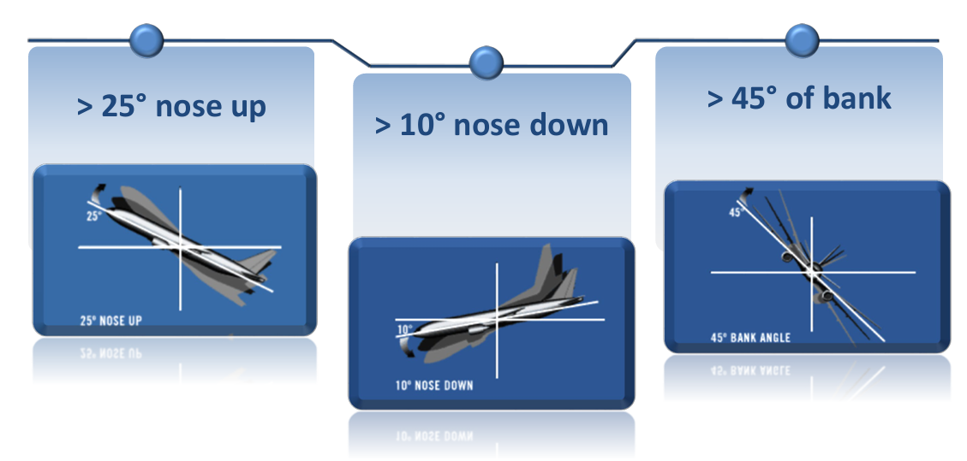
Definition of UPSET
Pitch attitude greater than 25 degrees nose up
Pitch attitude greater than 10 degrees nose down
Bank angle greater than 45 degrees
Within the above parameter, but flying at airspeeds inappropriate for the conditions
CAAT :: GUIDANCE MATERIAL for Loss of Control Prevention and Upset Recovery Training
Notes:
---
นิยามของ Upset ประกอบด้วย 4 ข้อหลัก ได้แก่ การเอียงเกิน 25 องศา, การเปลี่ยนมุม pitch อย่างรวดเร็วเกิน 10 องศา, ความเร็วที่อยู่นอกช่วงปกติ และการควบคุมที่ไม่เหมาะสม การเข้าใจนิยามนี้ช่วยให้นักบินรับรู้และเตรียมพร้อมรับมือได้ดีขึ้น
แหล่งที่มาของรูปภาพ: ไลบรารีเนื้อหาของ Microsoft 365

Slide 12
Key of Training
Knowledge
Skill
FSTD
Recognize
Prevention (Primary Goal)
Avoidance
Recovery
Startle
Surprise
Unexpected
Unplanning

Slide 13
Knowledge
ความรู้ที่เกี่ยวข้อง

Slide 14

Aerodynamic

Slide 15
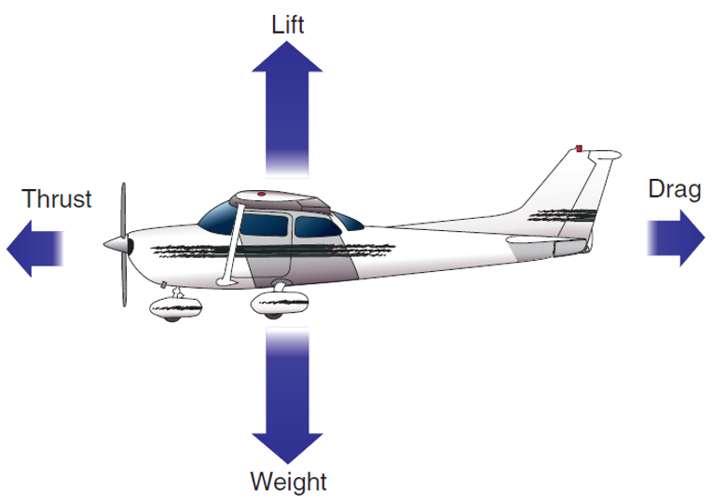
Aerodynamic

Slide 16
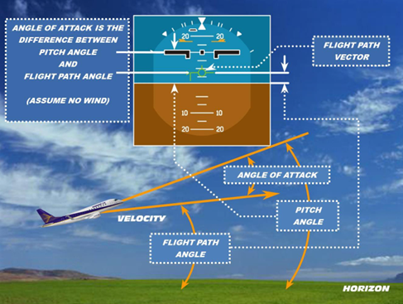
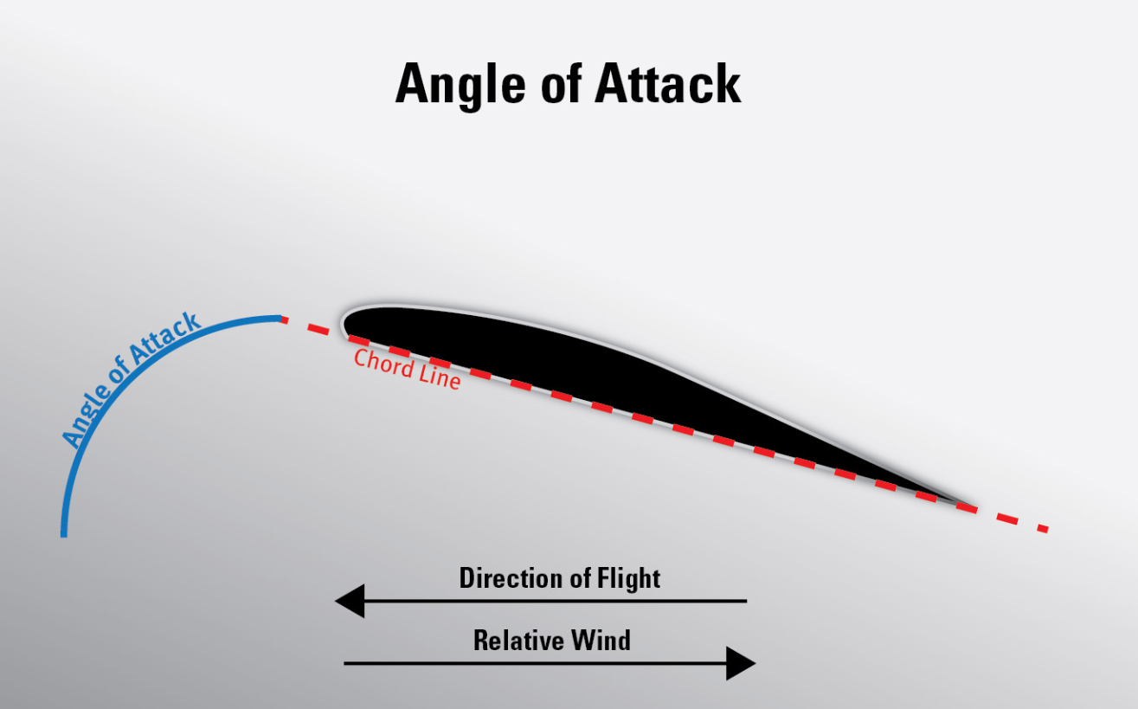
Angle of attack (AOA)
มุมที่ทำกับ Flight path

Slide 17
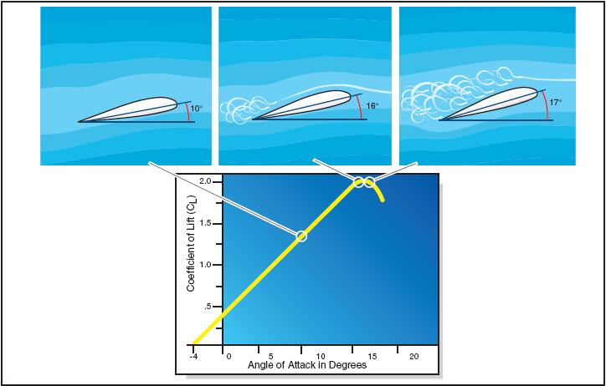
Critical Angle of attack

Slide 18
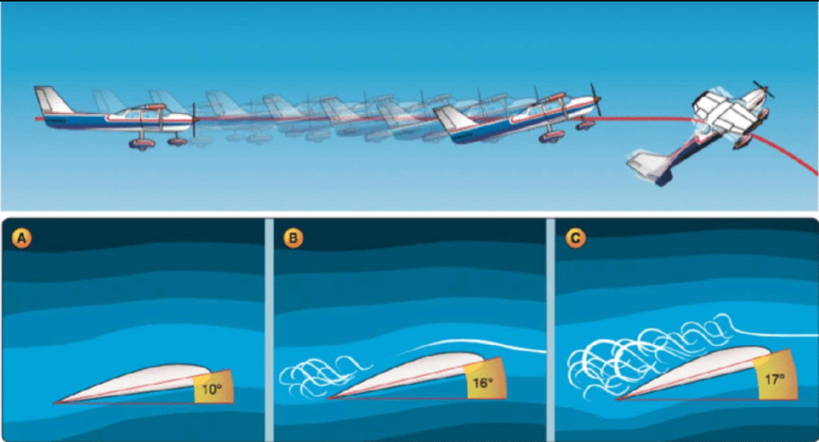
Stall

Slide 19

Energy Management

Slide 20
Three Sources of Ennergy
Kinetic Energy
Potential Energy
Chemical Energy
Increases with increasing speed
Approximately proportional to altitude
Come form energy thrust by consuming fuel

Slide 21
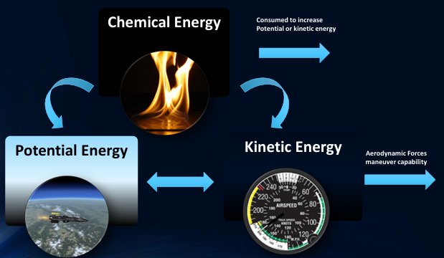
Energy Relationship

Slide 22

VG Diagram
Velocity-Load Factor Diagram

Slide 23
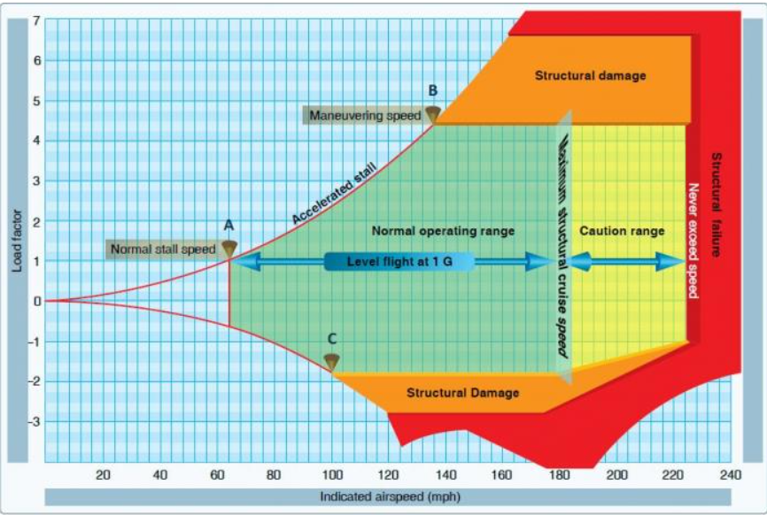
Stall
Stall

Slide 24
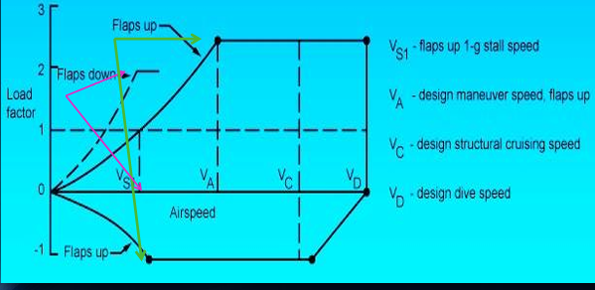

Slide 25
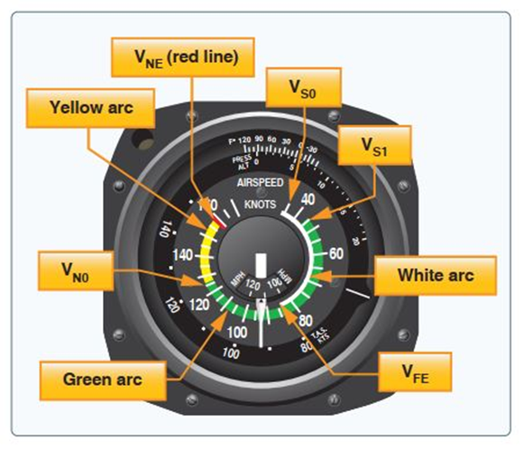
VG Diagram
White Arc
Green Arc
Red Arc
Yellow Arc

Slide 26

VG Diagram & G-limit
VS0
VS1
VFE
VN0
VNE

Slide 27
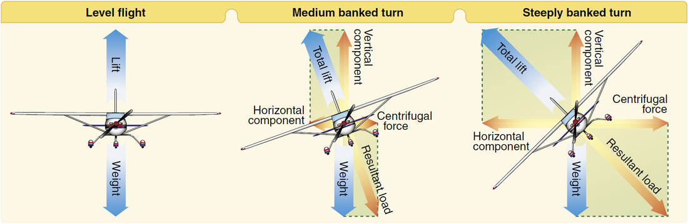
Load Factor

Slide 28
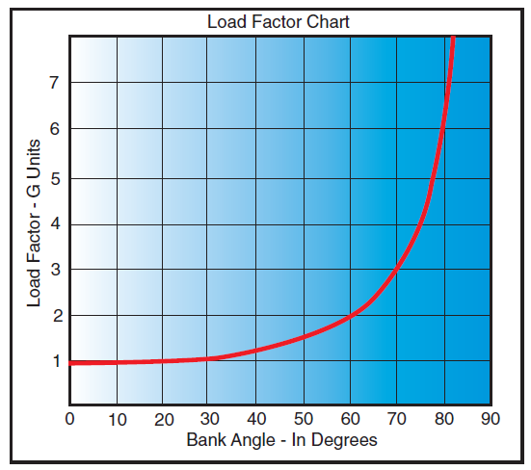
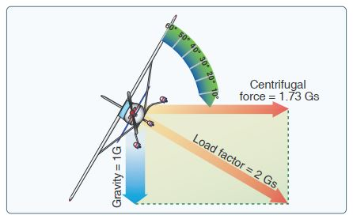
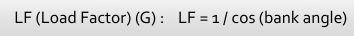
Load Factor

Slide 29
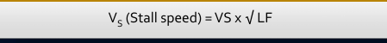

Load Factor

Slide 30

Causes And Contribution Faction of Upset

Slide 31
Causes And Contribution Faction of Upset
Environment
Turbulence
Airplane Icing
Pilot-induced
Instrument Cross Check
Inattention & Distraction
Vertigo
Somatotropic Illusion
Pilot Technica
Mechanical
Flight Instrument
Auto flight Systems
Flight Control Anomalies
Thunder Strom
Windshear
Microburst
Pilot Incapacitation
Improper use of airplane

Slide 32

Environment
Turbulence
Thunder Strom
Windshear
Microburst
Airplane Icing

Slide 33
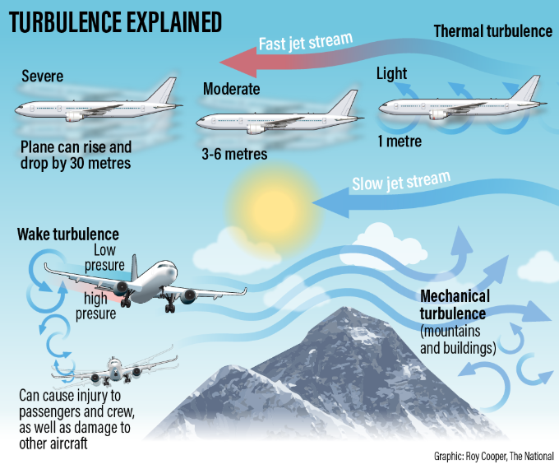
Environment
Turbulence
  Wake Turbulence
  Thermal Turbulence
  Clear Air Turbulence
  Mechanical Turbulence

Slide 34

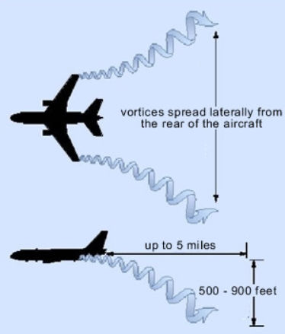
Environment
Wake Turbulence

Slide 35
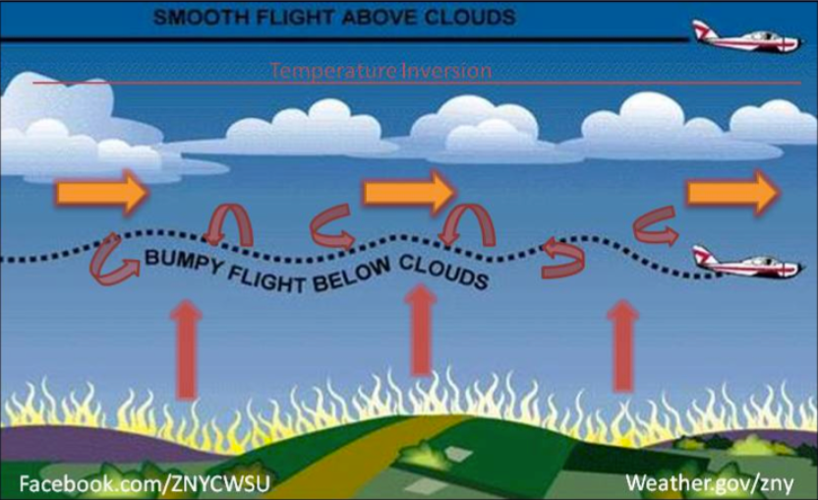
Environment
Thermal Turbulence

Slide 36
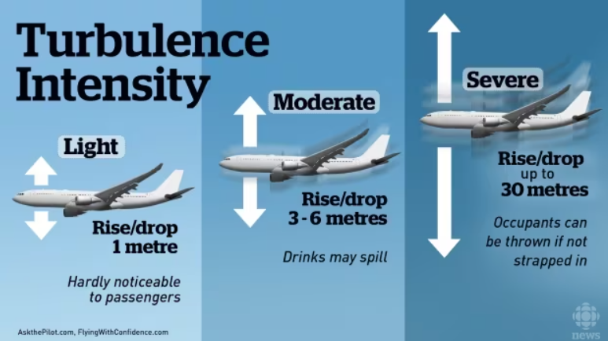
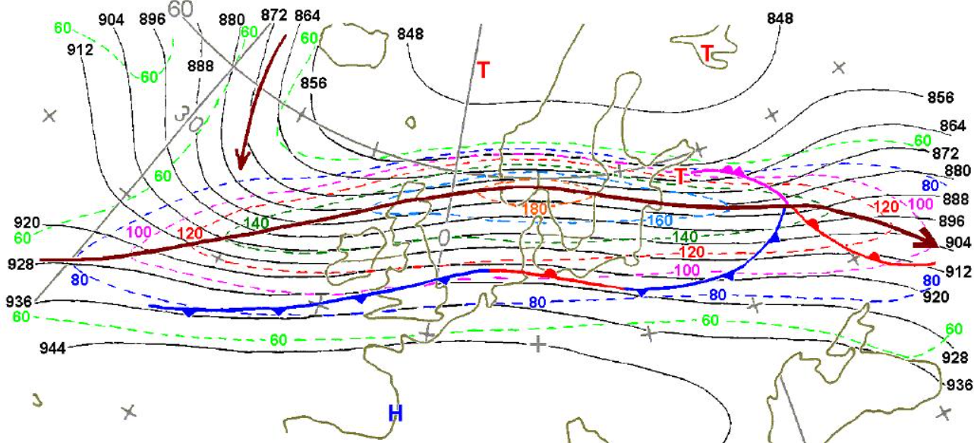
Environment
Clear Air Turbulence

Slide 37
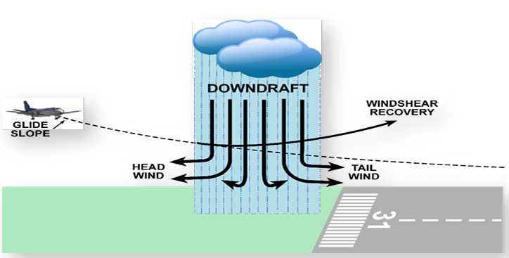
Environment
Windshear
• Caused by a rapid change in wind velocity in a short distance
• Caused by thunderstorms / rain showers / frontal conditions / Wave / Cumulus. These can produce violent windshear
• Some airports have LLWAS / TDWR systems to give warning of this condition

Slide 38
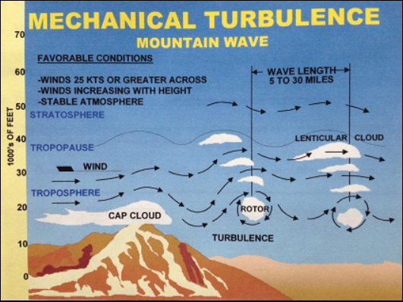
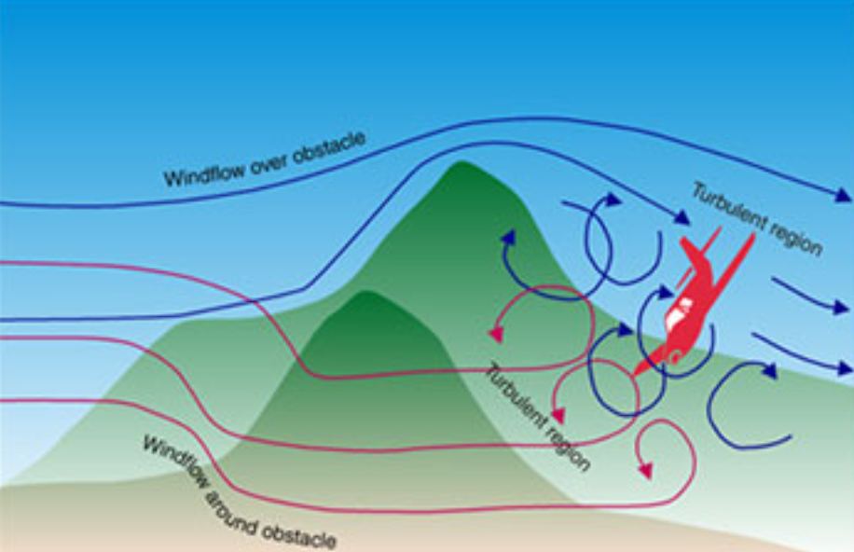
Environment
Mechanical Turbulence

Slide 39
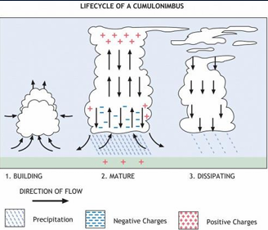
Environment
Thunder Strom
3 Stages
- Building
Mature
Dissipating
May have a leading cold air gust in advance of the cloud mass

Slide 40
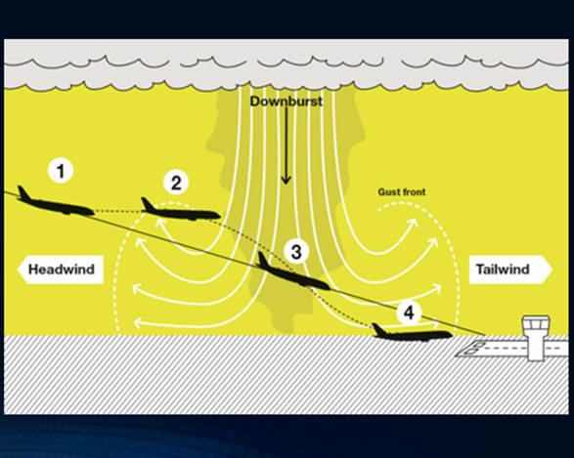
Environment
Microburst
Airspeed Variation > 15 kts
Groundspeed variations of shift from head wind to tail wind
Vs excursion of > 500 fpm
Pitch attitude of > 5 degree
Groundspeed deviation of > one dot
HDG Variation of > 10 degree
Unusual AT activity
Go- Around

Slide 41
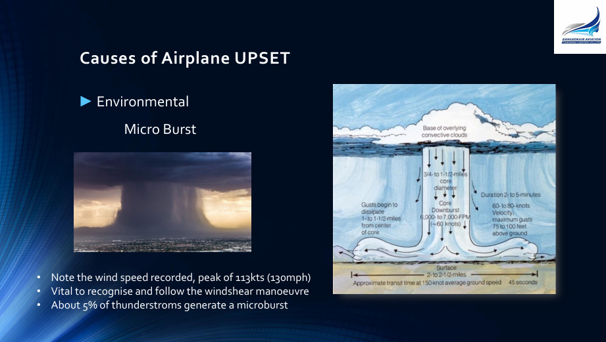
Environment
Microburst
Note the wind speed recorded, peak of 113 Kts (130 Mph)
Vital to recognize and follow the windshear maneuver
About 5 % of thunderstorm generate a microburst

Slide 42
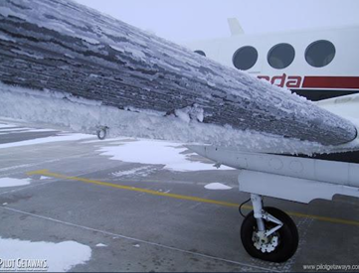
Environment
Airplane Icing
the aero foil section is affected
Lift generation is affected
Stall warning devices become of little use

Slide 43

Pilot-induced
Instrument Cross Check
Inattention & Distraction
Vertigo
Somatotropic Illusion
Pilot Technica
Pilot Incapacitation
Improper use of airplane

Slide 44

Pilot-induced
Instrument Cross Check
Inattention & Distraction
Pilot should
Be aware of the aircraft state
Assess risk and decide on a response
Detect and communicate deviations
Communicate expectation
Update / communicate understanding
Take timely corrective action

Slide 45

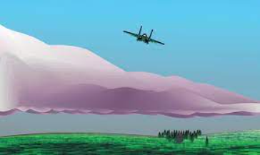

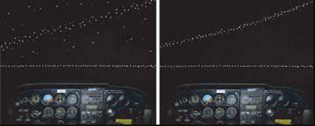
Pilot-induced
Vertigo
Flying over sloping cloud decks / Sloping land (False Horizon)
Aurora borealis with false Vertical and horizontal cues
Black hole at night

Slide 46
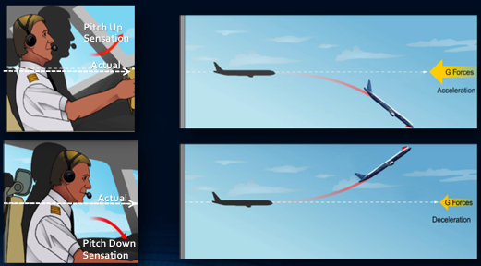
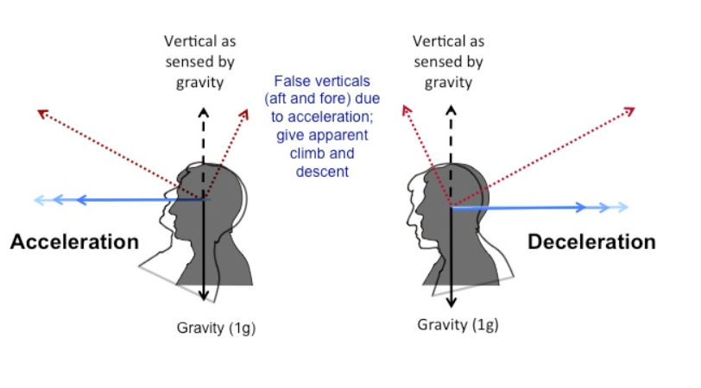
Pilot-induced
Somatotropic illusion

Slide 47
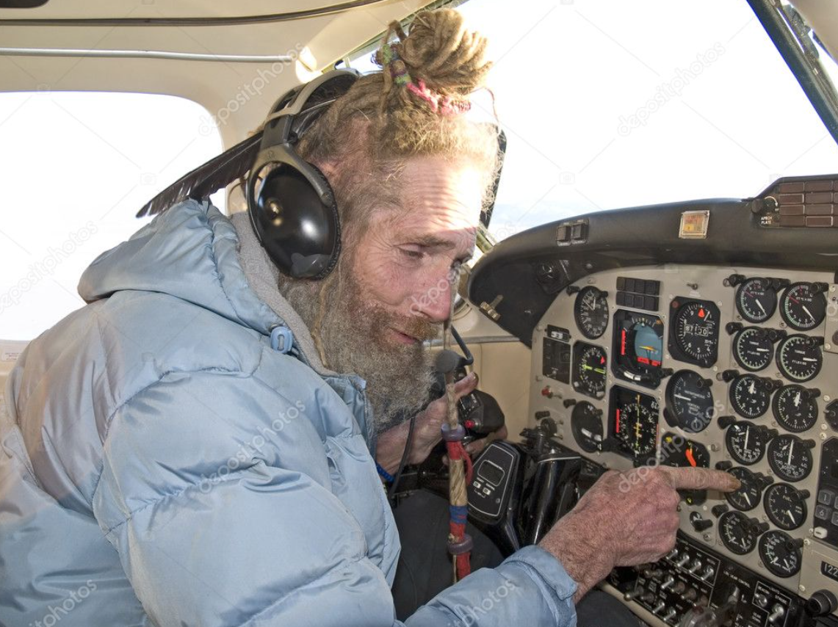
Pilot-induced
Pilot Technical
Recognize the developing upset and able to safely correct the situation
Unaware that upset event is developing or has occurred and fails to make essential decisions or take correction to prevent LOC-I

Slide 48
Pilot-induced
Pilot Technical
Pilot unable to affect recovery
  Not understanding the event
  Lacking the skill required
  Exceeding psychological or physiological ability to cope with what happening

Slide 49
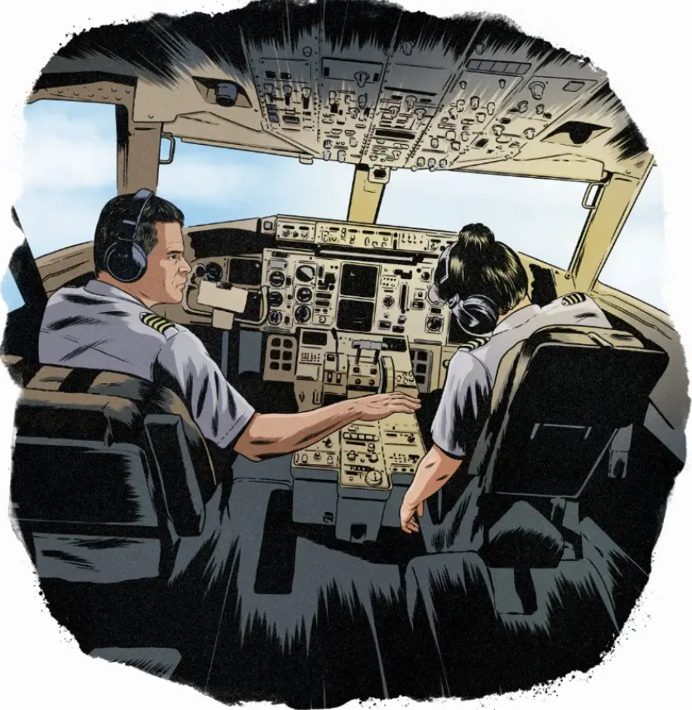
Pilot-induced
Pilot Incapacitation
Hypoxia
Sleepless
Sensor Overload or stressed
Tark Saturation
Surprise &Startle

Slide 50
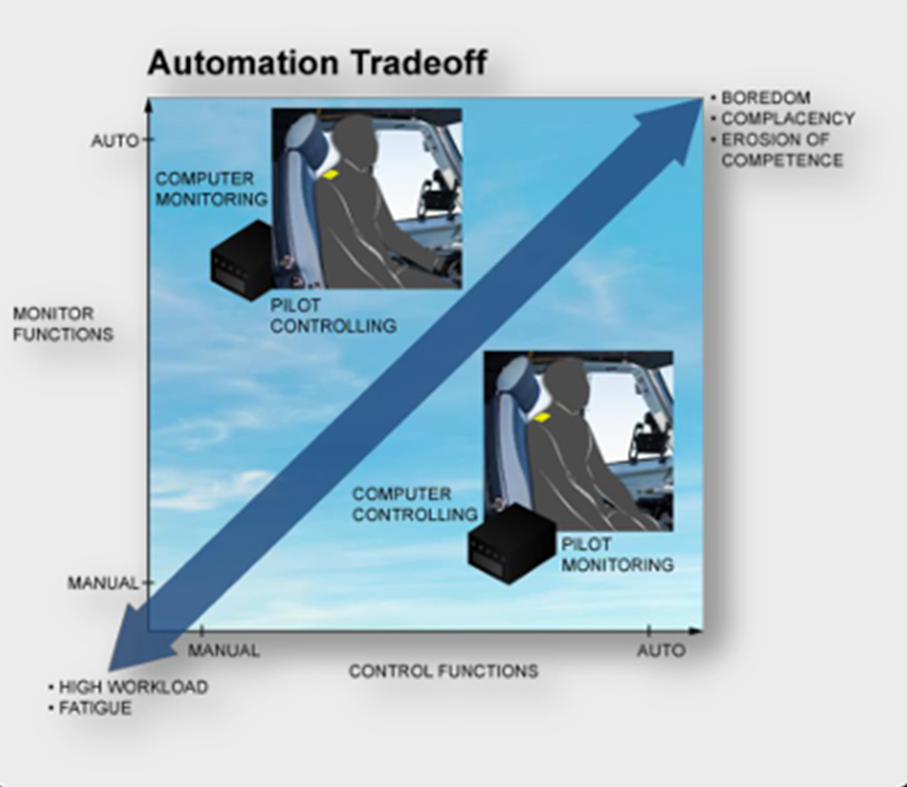
Pilot-induced
Improper use of airplane
If you are in a “mess” because of automation , Take over and stabilize

Slide 51
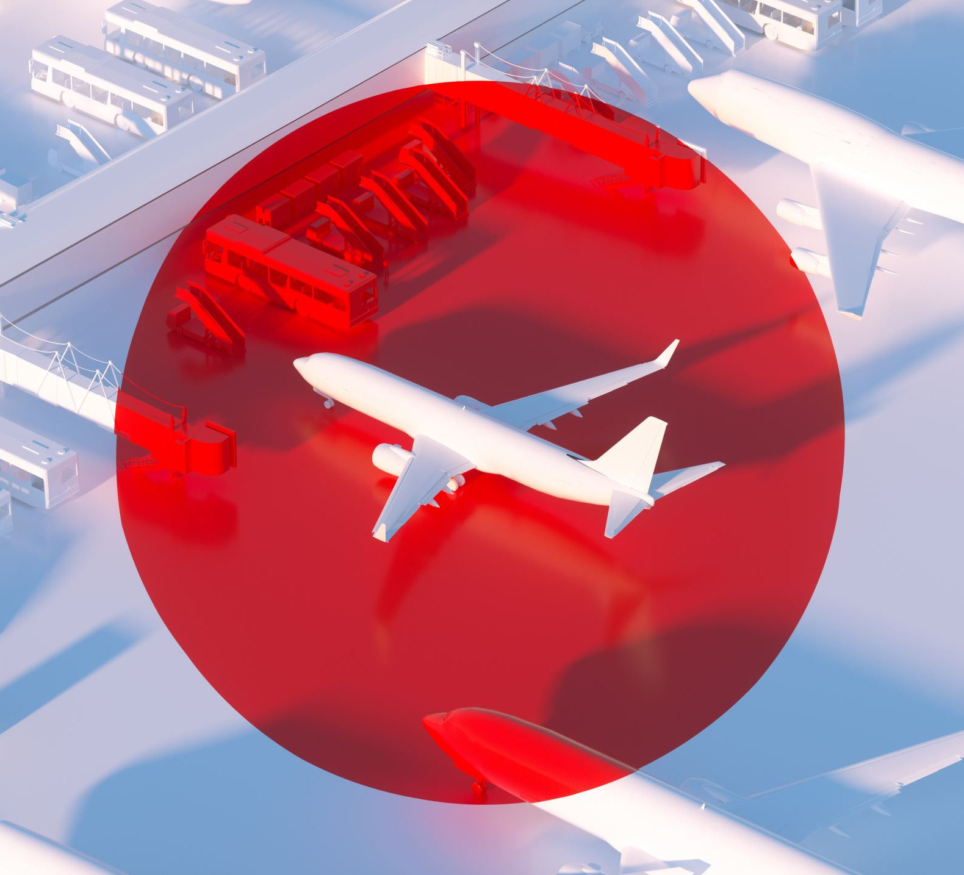
System Anomalies
Flight Instrument
Auto flight Systems
Flight Control Anomalies

Slide 52
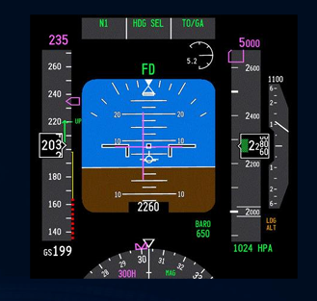
System Anomalies
Flight Instrument
Pitot Block
Error Computing
Failure

Slide 53
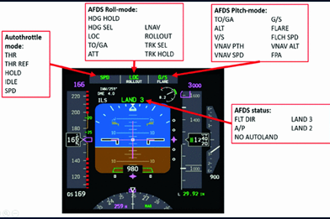
System Anomalies
Auto flight System
Auto pilot malfunction
  Nose down to overspeed
  Auto pilot Misinterpretation (Pilot don’t understand)

Slide 54

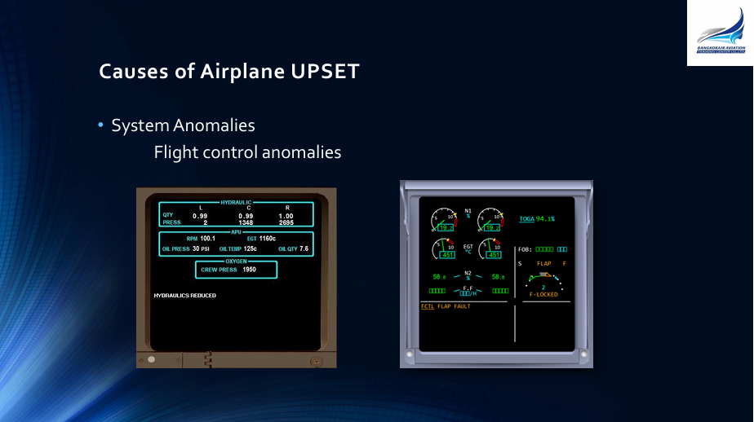
System Anomalies
Flight control Anomalies
Jamming
Asymmetric Spoiler Development
Asymmetric Thrust

Slide 55
UPRT Strategy

Slide 56
UPRT Strategy
Recognize
Confirm
Recovery
UNLOAD
ROLL
THRUST
STABILIZE

Slide 57
UPRT Strategy
UNLOAD
ROLL
THRUST
STABILIZE
(Push) means to reduce the Angle of Attack (AoA)
• 0.5 G is a good target.– Note: most aircraft do not come with G meters
• This is a “light in the seat” feeling
• This does not mean you are aiming for negative G – It means you are decreasing the load on the wing while staying at a positive “g” load
• This does not always mean to Push the sidestick forward – Relaxing the pressure can be enough sometimes, but will always require an unloading

Slide 58
UPRT Strategy
UNLOAD
ROLL
THRUST
STABILIZE
• Reduces AOA to less than critical Angle of Attack (stall). This avoids instability and buffeting
• Maximizes roll rate since the differential lift from ailerons is more effective at reduced angles of attack
• Helps the nose come down in nose high attitudes
• Reduces the increase in dive angle in over banked situation
Note : It is important to reduce the G Loading before rolling to avoid asymmetrical G loading. (A rolling pull or spiral dive)

Slide 59
UPRT Strategy
UNLOAD
ROLL
THRUST
STABILIZE
• In many cases Rudder just needs to be neutralized or left alone
• CAUTION : DO NOT APPLY CYCLICAL MOVEMENT as this may cause structural damage
• It should only be used cautiously to cancel out a yawing movement during the Push step

Slide 60
UPRT Strategy
UNLOAD
ROLL
THRUST
STABILIZE
• In most situations the Roll step requires the wings brought to level
• In some circumstances a bank can be added to reduce the vertical component of lift in nose high scenarios
• This must be executed with careful use of the elevator– Nose High – may cause a stall– Nose Low –may cause a spiral dive

Slide 61
UPRT Strategy
UNLOAD
ROLL
THRUST
STABILIZE
• Manage Thrust & Drag • Thrust means either an increase or a decrease of energy
• Decide which is required - check:– Current airspeed AND – Speed trend
• Thrust, if reduced or added, may have to be reconsidered again in the recovery as the aircraft’s energy state changes
• Speed brakes are also a tool during the Thrust step

Slide 62
UPRT Strategy
UNLOAD
ROLL
THRUST
STABILIZE
• STABILIZE returning to and maintaining the desired flight path stable and under control by establishing: – Desired pitch attitude– Bank– Power selection– Airspeed– Trim and configuration (Flaps, L/G etc)
• At low altitudes generally means: – To climb
• At higher altitudes this would mean: – Establishing a climb or – Descent to rejoin appropriate flight path

Slide 63
UPRT Strategy
Standard Recovery Technique
Alternate Recovery Technique
UNLOAD
ROLL
THRUST
STABILIZE
UNLOAD
THRUST
ROLL
STABILIZE

Slide 64
UPRT Strategy
UNLOAD
THRUST
ROLL
STABILIZE
• The Alternate Strategy, THRUST before ROLL, can be used with certain aircraft types and/or specific situations
– Airplanes with underslung engines
– Nose high / Low airspeed Upset
– Single engine stall
• Memorize the “UPRT” Strategy routinely until it is part of your personal aviation toolbox
• Each step is a separate event and should not be done simultaneously with another step (say and do, step by step)

Slide 65
UPRT Strategy
UNLOAD
THRUST
ROLL
STABILIZE
• Startle factor
– Freezing at the controls
– Pulling back on sidestick when looking at the ground
– Applying opposite aileron with a wing drop at the stall.
– Uncontrolled forward push of the sidestick– Forgetting to make power inputs– Cyclic movement of the rudder or using it to control roll

Slide 66
Unusual Attitudes
VS
Upset

Slide 67
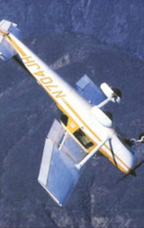
Unusual Attitudes Versus Upsets
Given the upset definition, there are a few key distinctions between an unusual attitude and an upset. An upset:
Includes stall events.
Includes overspeed or other inappropriate speeds for a given flight condition.
Centers on unintentional situations that may lead to a startle effect
Has defined parameters.

Slide 68
Definition of UPSET
Pitch attitude greater than 25 degrees nose up
Pitch attitude greater than 10 degrees nose down
Bank angle greater than 45 degrees
Within the above parameter, but flying at airspeeds inappropriate for the conditions
CAAT :: GUIDANCE MATERIAL for Loss of Control Prevention and Upset Recovery Training
Notes:
---
นิยามของ Upset ประกอบด้วย 4 ข้อหลัก ได้แก่ การเอียงเกิน 25 องศา, การเปลี่ยนมุม pitch อย่างรวดเร็วเกิน 10 องศา, ความเร็วที่อยู่นอกช่วงปกติ และการควบคุมที่ไม่เหมาะสม การเข้าใจนิยามนี้ช่วยให้นักบินรับรู้และเตรียมพร้อมรับมือได้ดีขึ้น
แหล่งที่มาของรูปภาพ: ไลบรารีเนื้อหาของ Microsoft 365

Slide 69
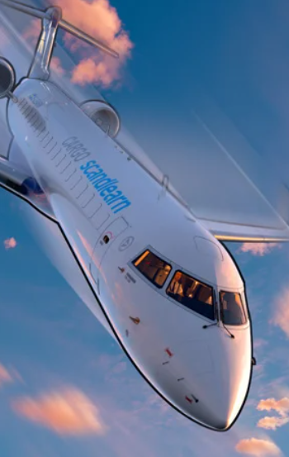
Upset Prevention and Recovery Training
UPRT is intended to focus education and training on the prevention of upsets, and on recovering from these events if they occur.
The top four causal and contributing factors that have led to an upset and resulted in LOC-I accidents are:
Environmental factors
Mechanical factors
Human factors
Stall-related factors

Slide 70
Aerobatic
VS
Upset

Slide 71
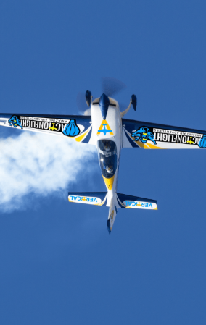
UPRT is different from aerobatic training
In aerobatic training, the pilot knows and expects the maneuver, so effects of startle or surprise are missing. The main goal of aerobatic training is to teach pilots how to intentionally and precisely maneuver an aerobatic-capable airplane in three dimensions.
The primary goal of UPRT is to help pilots overcome sudden onsets of stress to avoid, prevent, and recover from unplanned excursions that could lead to LOC-I.

Slide 72
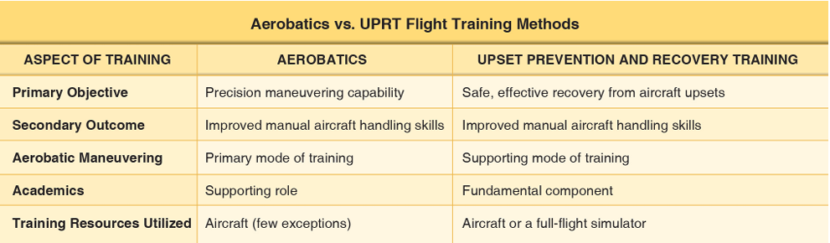
Aerobatic VS Upset Prevention & Recovery

Slide 73
Air work

Slide 74
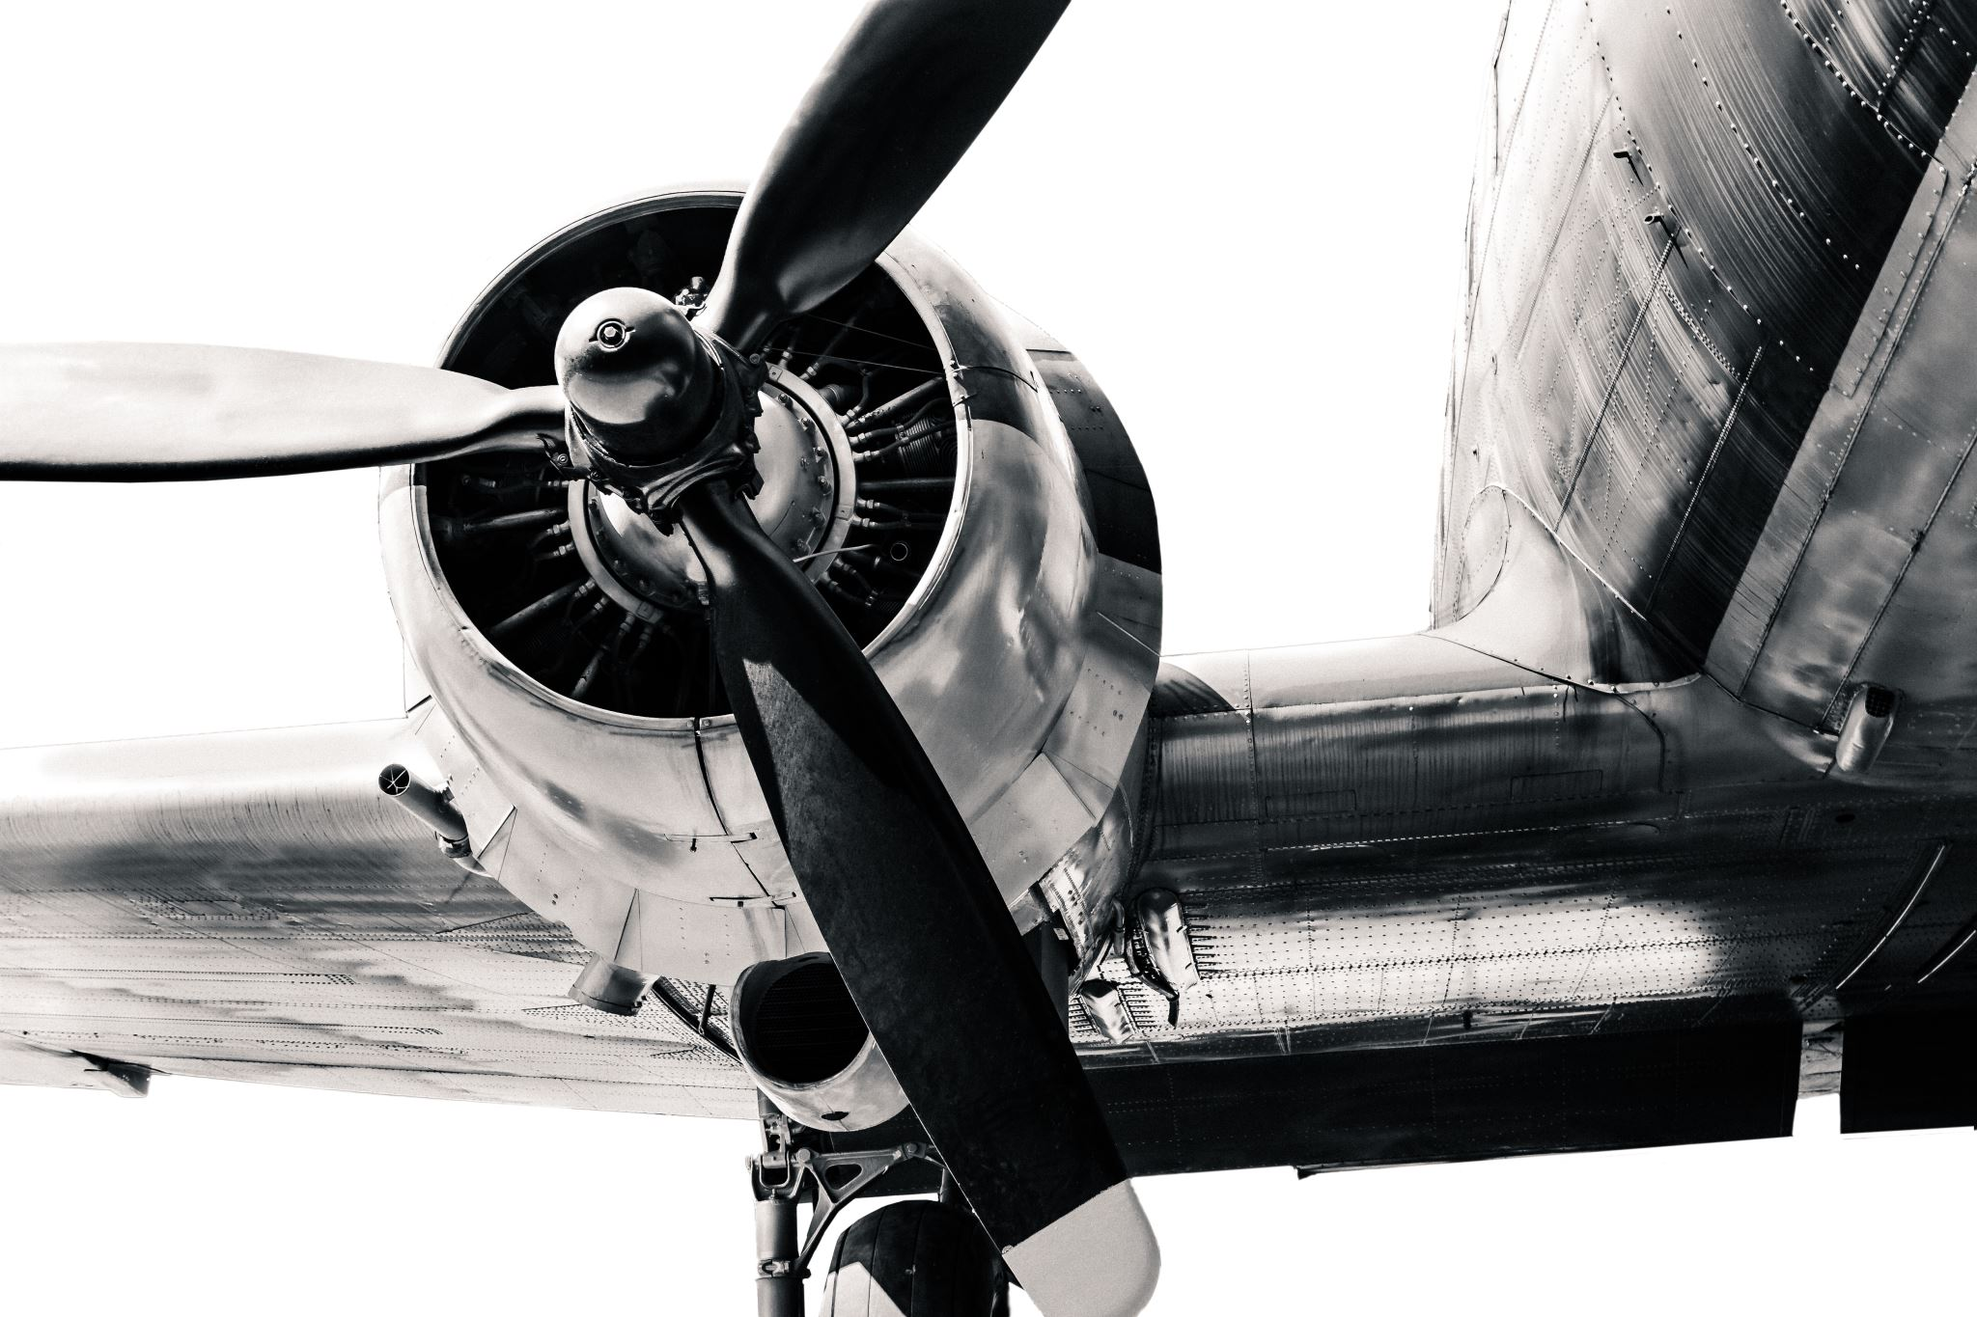
Upset Prevention and Recovery Training (UPRT)
To develop the crucial skills to prevent LOC-I, a pilot may receive academic or on-aircraft upset prevention and recovery training (UPRT), which should include :: slow flight, stalls, spins, and unusual attitudes.

Slide 75
Air work
Spiral Dive
Slow flight
Steep Turn
Recovery form Approach to stall
Recovery form stall (different Configuration)
Recovery form stall (Uncoordinated)
Nose-High / High Speed Recovery
Nose-High / Low Speed Recovery
Nose-Low / High Speed Recovery
Nose-Low / Low Speed Recovery
High Bank Angle Recovery
Slow Flight
Steep Turn
Power On / Off stall Recovery
Nose High Recovery
Nose Low Recovery

Slide 76

Slow Flight

Slide 77
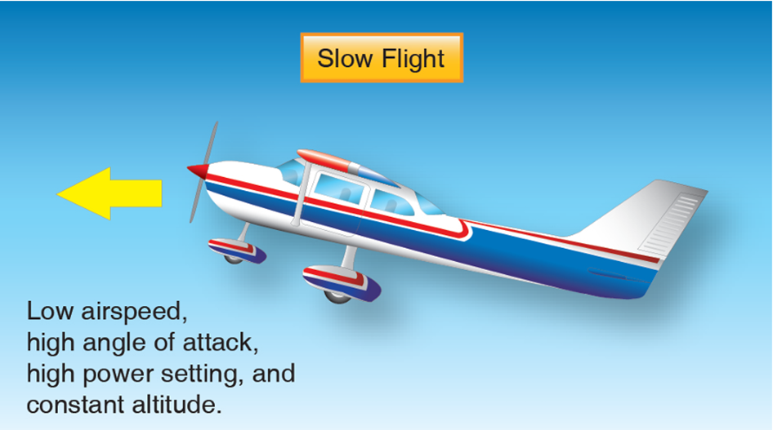
The objective of maneuvering in slow flight is to develop the pilot’s ability to fly at low speeds and high AOAs. Through practice, the pilot becomes familiar with the feel, sound, and visual cues of flight in this regime, where there is a degraded response to control inputs and where it is more difficult to maintain a selected altitude.

Slide 78
Slow Flight
For pilot training and testing purposes, slow flight includes two main elements:
Slowing to, maneuvering at, and recovering from an airspeed at which the airplane is still capable of maintaining controlled flight without activating the stall warning—5 to 10 knots above the 1G stall speed is a good target.
Performing slow flight in configurations appropriate to takeoffs, climbs, descents, approaches to landing, and go-arounds.

Slide 79
Slow Flight
Slow flight training includes:
Slowing the airplane smoothly and promptly from cruising to approach speeds without changes in altitude or heading, while increasing the angle of attack and setting the required power and trim.
Configuration changes, such as extending the landing gear and adding flaps, while maintaining heading and altitude.
Turning while maintaining altitude.
Straight-ahead climbs and climbing medium-banked (approximately 20 degrees) turns, and straight-ahead power-off gliding descents and descending turns, which represent the takeoff and landing phases of flight.

Slide 80
Slow Flight
Slow flight training includes:
To exit the slow flight maneuver, add power. As airspeed and lift increase, apply forward control pressure to reduce the AOA and maintain altitude. Maintain coordinated flight, level the wings as necessary, and return to the desired flightpath. As airspeed increases, clean up the airplane by retracting flaps and landing gear, if they were extended, and adjust trim as needed. A pilot should anticipate the changes to the AOA as the landing gear and flaps are retracted to avoid a stall.

Slide 81
Slow Flight
Common Errors
Failure to adequately clear the area
Inadequate back-elevator pressure as power is reduced, resulting in altitude loss
Excessive back-elevator pressure as power is reduced, resulting in a climb followed by rapid reduction in airspeed
Insufficient right rudder to compensate for left yaw.
Fixation on the flight instruments
Failure to anticipate changes in AOA as flaps are extended or retracted
Inadequate power management
Inability to adequately divide attention between airplane control and orientation
Failure to properly trim the airplane
Failure to respond to a stall warning

Slide 82
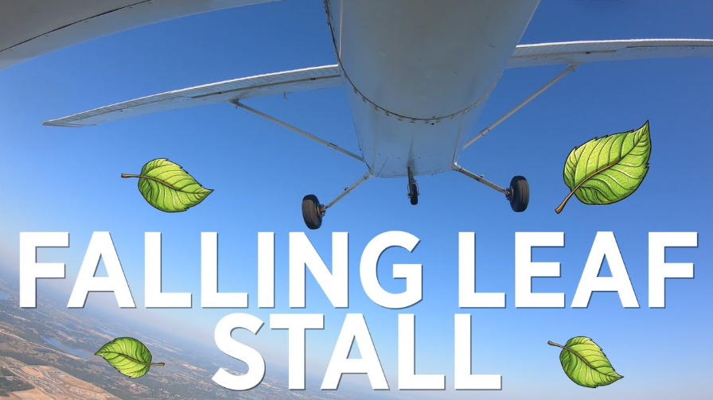
Stall

Slide 83
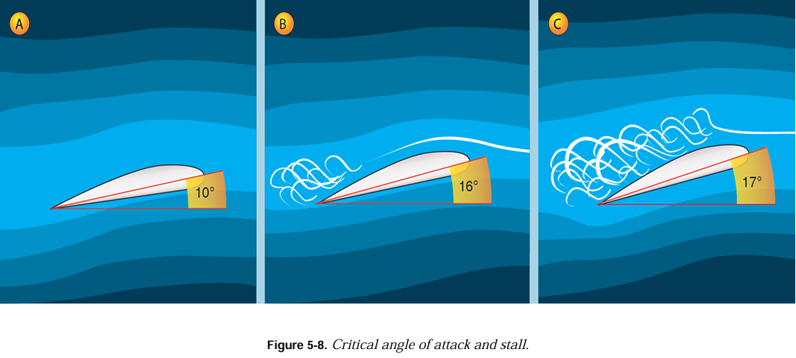
STALL
A stall is an aerodynamic condition which occurs when smooth airflow over the airplane’s wings is disrupted, resulting in loss of lift.
Specifically, a stall occurs when the AOA—the angle between the chord line of the wing and the relative wind—exceeds the wing’s critical AOA.
It is possible to exceed the critical AOA at any airspeed, at any attitude, and at any power setting

Slide 84
STALL
Stalls are practiced to two different levels:
Impending Stall—an impending stall occurs when the AOA causes a stall warning, but has not yet reached the critical AOA. Indications of an impending stall can include buffeting, stick shaker, or aural warning.
⦁Full Stall—a full stall occurs when the critical AOA is exceeded. Indications of a full stall are typically that an uncommanded nose down pitch cannot be readily arrested, and may be accompanied by an uncommanded rolling motion. For airplanes equipped with stick pushers, their activation is also an indicator of a full stall.

Slide 85
STALL
Stall Recognition
Stalls are usually accompanied by a continuous stall warning for airplanes equipped with stall warning devices. These devices may include an aural alert, lights, or a stick shaker all which alert the pilot when approaching the critical AOA.

Slide 86
STALL
Stall Recognition
Other sensory cues for the pilot include:
⦁ Feel—the pilot will feel control pressures change as speed is reduced.
⦁ Vision—since the airplane can be stalled in any attitude, vision is not a foolproof indicator of an impending stall. However, maintaining pitch awareness is important.
⦁ Hearing—as speed decreases, the pilot should notice a change in sound made by the air flowing along the airplane structure.
⦁ Kinesthesia—the physical sensation (sometimes referred to as “seat of the pants” sensations) of changes in
direction or speed is an important indicator to the trained and experienced pilot in visual flight.

Slide 87
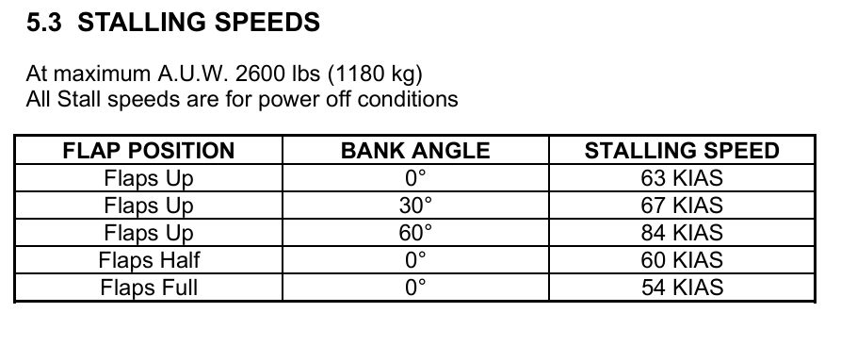
STALL
Different airplane designs can result in different stall characteristics. The pilot should know the stall characteristics of the airplane being flown and the manufacturer’s recommended recovery procedures. Most training airplanes are designed so that the wings stall progressively outward from the wing roots (where the wing attaches to the fuselage) to the wingtips.

Slide 88
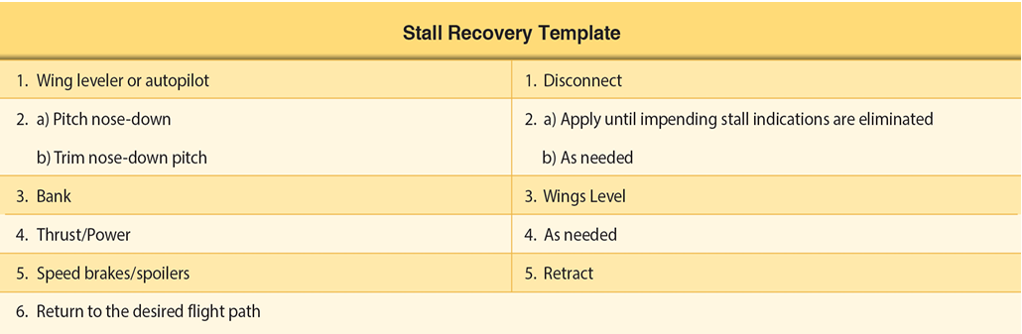
STALL

Slide 89

Stall Training
Practice in both power-on and power-off stalls is important because it simulates stall conditions that could occur during normal flight maneuvers.
It is important for pilots to understand the possible flight scenarios in which a stall could occur. Stall accidents usually result from an inadvertent stall at a low altitude, with the recovery not completed prior to ground contact.

Slide 90
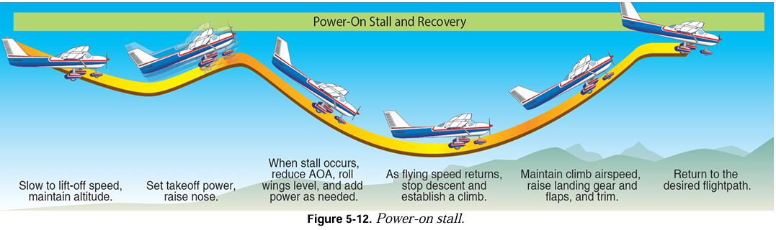
Stall Training (Power on stall)
Power-on stalls are practiced to develop the pilot’s awareness of what could happen if the airplane is pitched to an excessively nose-high attitude immediately after takeoff, during a climbing turn, or when trying to clear an obstacle.

Slide 91
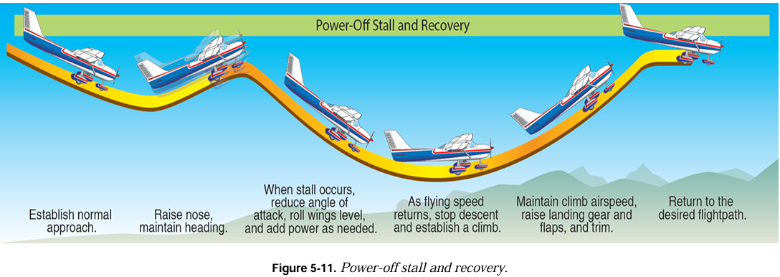
Stall Training (Power off stall)
Power-off stalls
Power-off turning stalls develop the pilot’s awareness of what could happen if the controls are improperly used during a turn from the base leg to the final approach.
Power-off straight-ahead stall simulates the stall that could occur when trying to stretch a glide after the engine has failed, or if low on the approach to landing.

Slide 92
Stall Training
Common Errors
Failure to adequately clear the area.
Over-reliance on the airspeed indicator and slip-skid indicator while excluding other cues after recovery.
Inadvertent accelerated stall by pulling too fast on the controls during a power-off or power-on stall entry.
Inability to recognize an impending stall condition.
Failure to take timely action to prevent a full stall during the conduct of impending stalls.
Failure to maintain a constant bank angle during turning stalls.

Slide 93
Stall Training
Common Errors
7. Failure to maintain proper coordination with the rudder throughout the stall and recovery.
8. Recovering before reaching the critical AOA when practicing the full stall maneuver.
9. Not disconnecting the wing leveler or autopilot, if equipped, prior to reducing AOA.
10. Recovery is attempted without recognizing the importance of pitch control and AOA.
11. Not maintaining a nose down control input until the stall warning is eliminated.
12. Pilot attempts to level the wings before reducing AOA.

Slide 94
Stall Training
Common Errors
13. Pilot attempts to recover with power before reducing AOA.
14. Failure to roll wings level after AOA reduction and stall warning is eliminated.
15. Inadvertent secondary stall during recovery.
16. Excessive forward-elevator pressure during recovery resulting in low or negative G load.
17. Excessive airspeed buildup during recovery.
18. Losing situational awareness and failing to return to desired flightpath or follow ATC instructions.

Slide 95

SPIN

Slide 96
Spin Awareness
A spin is an aggravated stall condition that may result after a stall occurs. Mishandling of yaw control during a stall increases the likelihood of a spin entry. A spin results in the airplane following a downward corkscrew path. During a spin, the airplane rotates around its vertical axis affected by different lift and drag forces on each wing, and the airplane descends due to gravity, rolling, yawing, and pitching in a spiral path.

Slide 97

Spin Procedures
Four phases of a spin:
Entry
Incipient
Developed
recovery

Slide 98
Spin Procedures
Entry Phase
The entry procedure for demonstrating a spin is similar to a power-off stall. During the entry, the pilot should slowly reduce power to idle, while
simultaneously raising the nose to a pitch attitude that ensures a stall.
As the airplane approaches a stall, the pilot smoothly applies full rudder in the direction of the desired spin rotation while applying full back (up) elevator to the limit of travel. Unless AFM/POH specifies otherwise, ailerons are maintained in the neutral position during the spin procedure.

Slide 99
Spin Procedures
Incipient Phase
The incipient phase occurs from the time the airplane stalls and starts rotating until the spin has fully developed. This phase may take two to four turns for most airplanes. In this phase, the aerodynamic and inertial forces have not achieved a balance. As the incipient phase develops, the indicated airspeed will generally stabilize at a low and constant airspeed and the symbolic airplane of the turn indicator should indicate the direction of the spin.

Slide 100
Spin Procedures
Developed Phase
The developed phase occurs when the airplane’s angular rotation rate, airspeed, and vertical speed are stabilized in a flightpath that is nearly vertical. In the developed phase, aerodynamic forces and inertial forces are in balance, and the airplane’s attitude, angles, and self-sustaining motions about the vertical axis are constant or repetitive, or nearly so.

Slide 101
Spin Procedures
Recovery Phase
The recovery phase occurs when rotation ceases and the AOA of the wings is decreased below the critical AOA. This phase may last for as little as a quarter turn or up to several turns depending upon the airplane and the type of spin. To recover, the pilot applies control inputs to disrupt the spin equilibrium by stopping the rotation and unstalling the wing. To accomplish spin recovery, the pilot should always follow the manufacturer’s recommended procedures.

Slide 102

Spin Procedures

Slide 103



Slide 104

Spiral Dive
A spiral dive, a nose-low upset, is a descending turn during which airspeed and G-load can increase rapidly and often results from a botched turn. In a spiral dive, the airplane is flying very tight circles, in a nearly vertical attitude and will be accelerating because it is no longer stalled

Slide 105


Slide 106


Slide 107

UNUSUAL ATTITUDE RECOVERY

Slide 108
UNUSUAL ATTITUDE RECOVERY
An unusual flight attitude can occur even with a properly trained instrument pilot, due to failure of the attitude indicator, disorientation, wake turbulence, lapse of attention, or abnormal trim.
To practice unusual attitude recoveries, your instructor might ask you to pass the controls and close your eyes. Then, your instructor will maneuver the airplane in such a way as to induce disorientation. After opening your eyes, you must take control of the airplane to make a proper recovery.

Slide 109

UNUSUAL ATTITUDE RECOVERY
NOSE-HIGH UNUSUAL ATTITUDE
Instrument Indications
The instrument indications of a nose-high unusual flight attitude are:
  A nose-high pitch of the aircraft symbol on
the attitude indicator.
  A rapidly increasing altitude on the altimeter.
  A high rate of climb on the vertical speed
indicator.
  A rapidly decreasing airspeed.

Slide 110

UNUSUAL ATTITUDE RECOVERY
NOSE-HIGH UNUSUAL ATTITUDE
Recovery Actions
To recover, perform these actions almost simultaneously but in the following sequence:
Add power.
Lower the nose to place the aircraft symbol on the horizon line of the attitude indicator.
Level the wings using the attitude indicator as a reference to return to the original attitude and heading

Slide 111
UNUSUAL ATTITUDE RECOVERY
NOSE-LOW UNUSUAL ATTITUDE
Instrument indications
The instrument indications of a spiraling nose-low unusual flight attitude are:
  A nose-low pitch of the aircraft symbol on the attitude indicator.
  A rapidly decreasing altitude on the altimeter.
  A high rate of descent on the vertical speed indicator.
  A rapidly increasing airspeed.

Slide 112

UNUSUAL ATTITUDE RECOVERY
NOSE-LOW UNUSUAL ATTITUDE
Recovery Actions
To recover, perform these actions almost simultaneously but in the following sequence:
  1. Reduce power.
  2. Level the wings using the attitude indicator as a reference.
  3. Raise the nose to place the aircraft symbol on the horizon line of the attitude indicator

Slide 113



References

Slide 114


